Slide 1
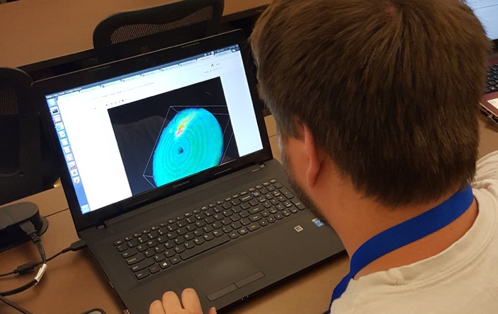
Radar Science and Code: Building Knowledge Beyond the Case Study
A talk in three parts…..
Scott Collis
Argonne National Laboratory
and many others…
Perdue EAPS Seminar. Thursday November 2nd

Slide 2
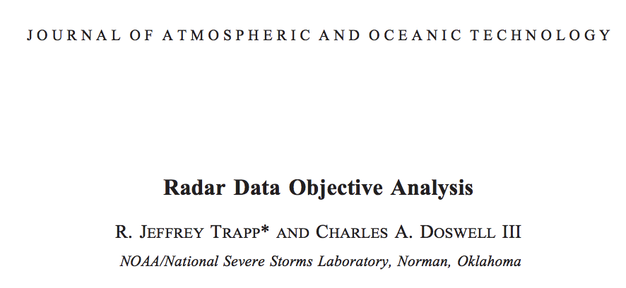

Slide 3
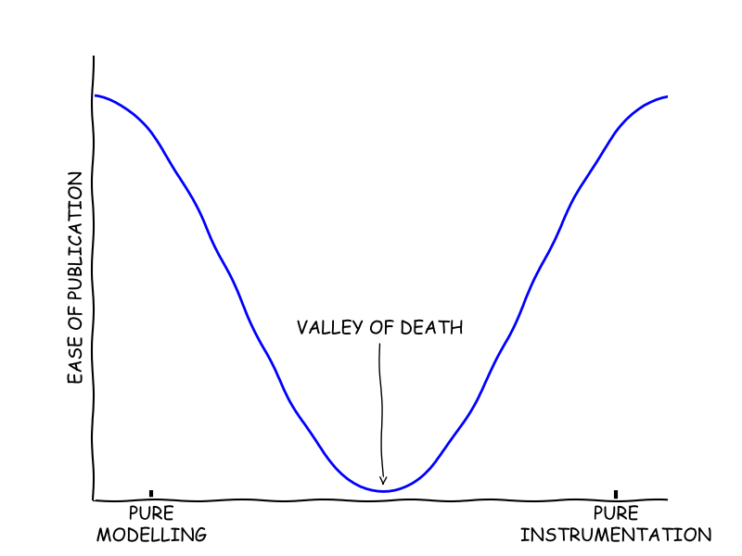
A Talk in three parts…
With an all important overture.. Well.. Two overtures…
This presentation will give you an idea of the work our research team is up to at Argonne.
We have diversified interests and are funded from a variety of sources.
But we have several unifying themes:
Open Source
Open Data
Getting past the case study (there is nothing wrong with the case study)
Being at DoE we have access to some nice toys!

Slide 4
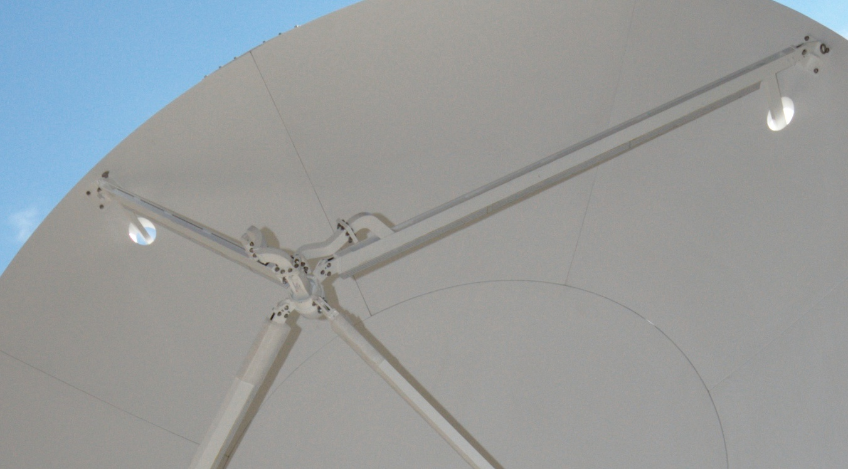
Polarimetric Radar crash course
A typical coherent radar transmits pulses of radiation with the electric field polarized aligned with the horizon, this is horizontal polarized radar.
Polarimetric radar, or dual polarized radar transmits both vertically and horizontally aligned as well as receiving both polarizations.
In addition to single pol measurements of reflectivity ( ) radial velocity and spectrum width polarimetric radars return:
Differential reflectivity (aka ZDR) which is the ratio between the horizontal and vertical returns, this is a measure of the oblateness of drops which are squished as they fall.. ~ D₀
Differential propagation phase (aka PhiDP), this is the difference in phase between the horizontal and vertical return and the specific differential phase (aka KDP) which is the radial differential of PhiDP. The relation between Kdp and the DSD is complex however can be approximated to the 4.24th moment in heavy rain and the 5.6th moment in light precipitation (Zrnić and Ryzhkov 1996).
Correlation coefficent (RhoHV), correlation between pols..

Slide 5
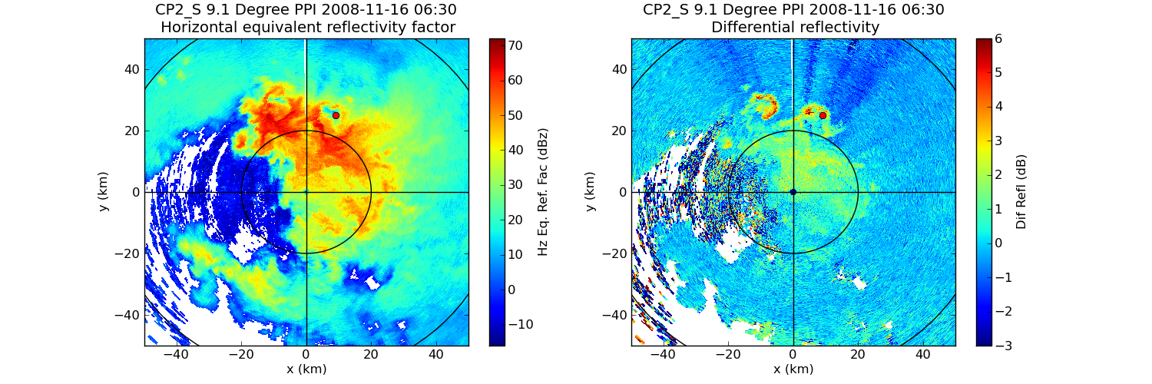
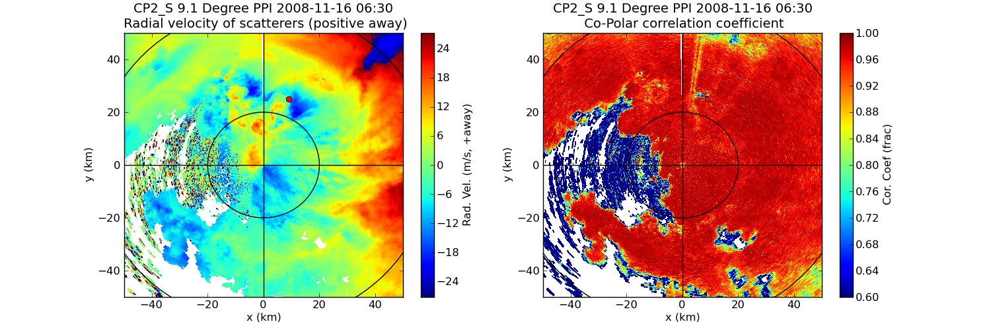
Why Bother?

Slide 6
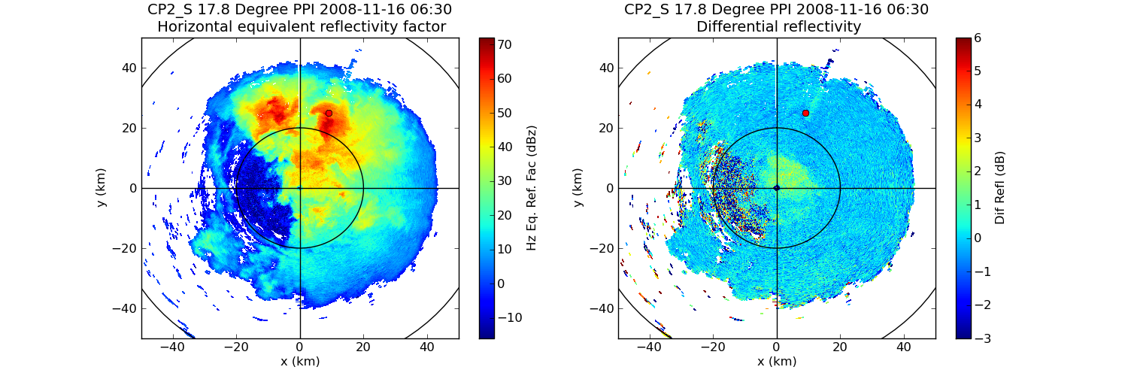
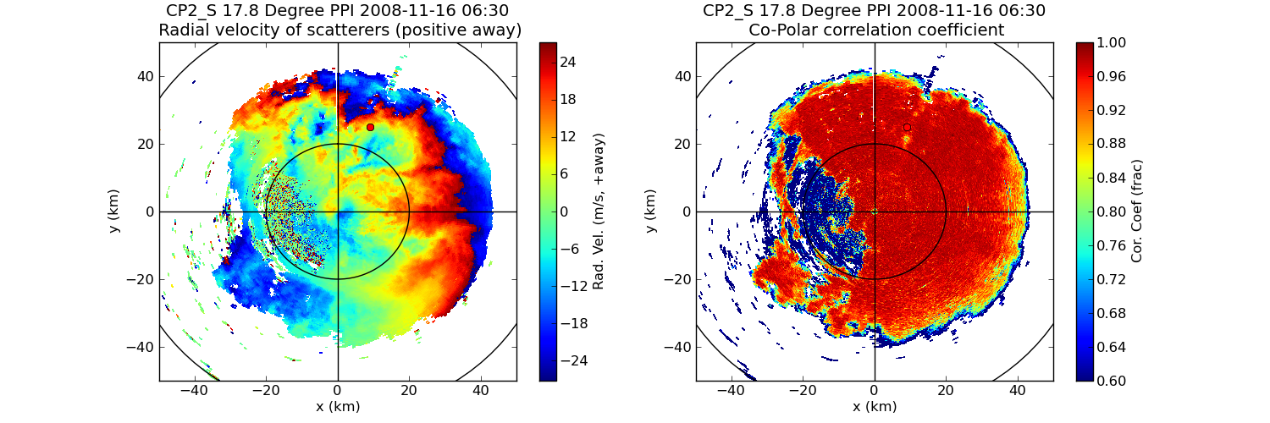
Why Bother?

Slide 7
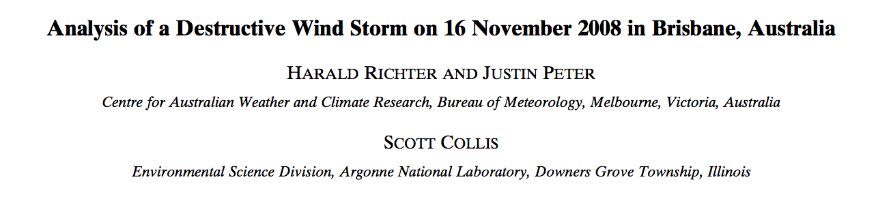
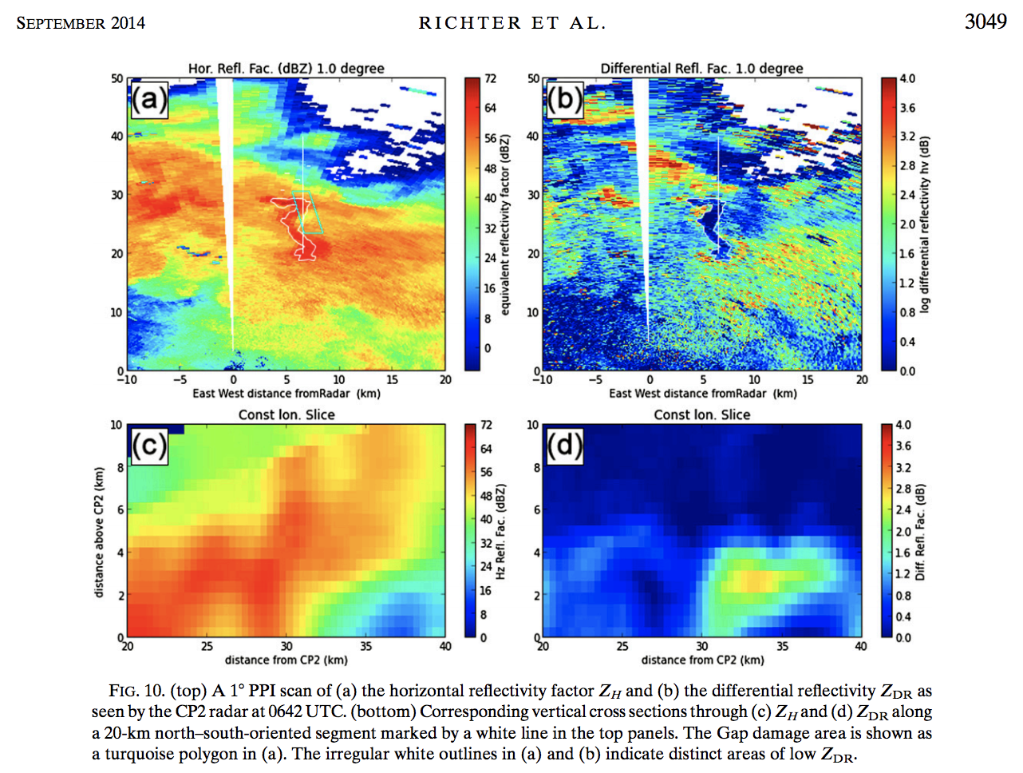

Slide 8
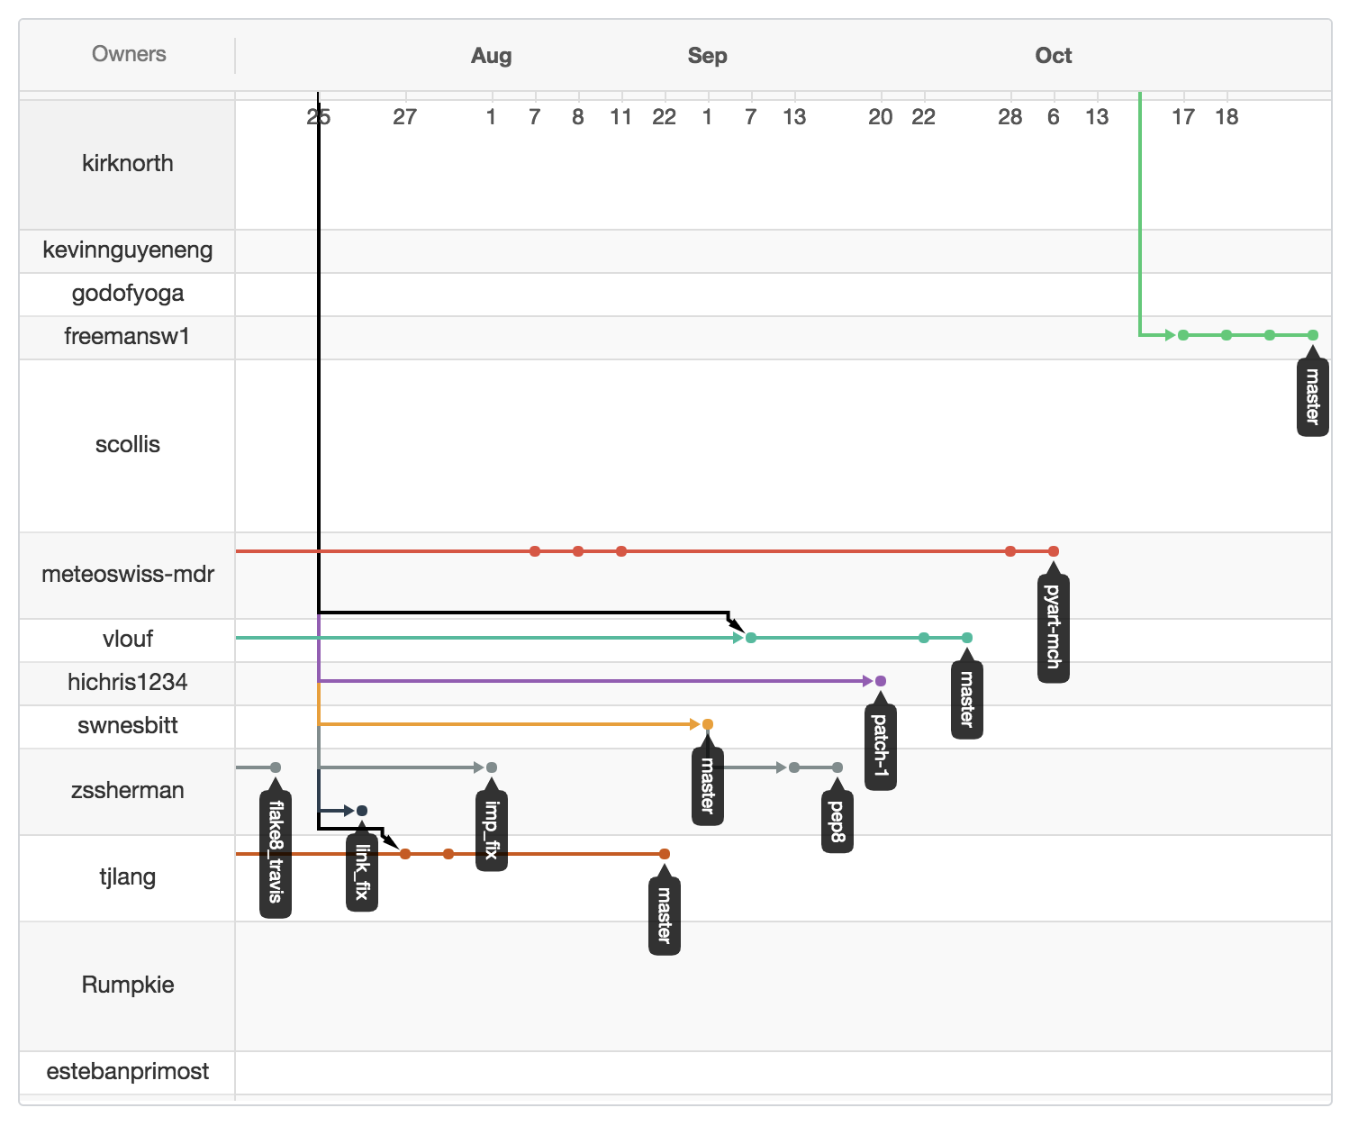
The Python ARM Radar Toolkit
Not just a tool.. The way we do business.
Py-ART is an open source community package that uses Python as its top level language designed for interacting with weather radar data.
Put simply Py-ART is a way of representing gated data in the Python programming language.
The Scientific Python community is huge with some deep pocketed backers. Py-ART helps us bring this to the Radar community.
17 Articles/Theses so far.

Slide 9
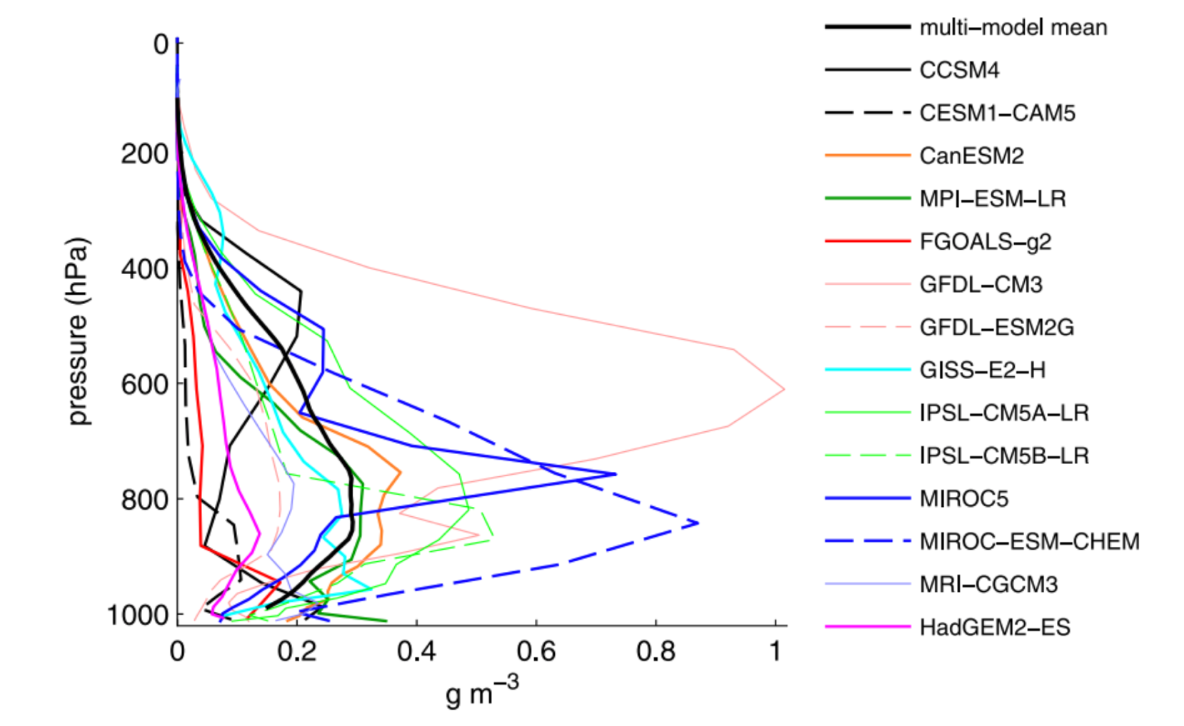
Part 1: History as prolog.
Using a 15 year data set to build the next generation climate model.
Convective processes are highly parameterized in models designed to be run on climate time scales.
There have been many iterations of deep convective schemes. Microphysics is gradually being introduced (yes.. Many schemes in CMIP5 did not have microphysics in some areas).
Arakawa pushed the science forward by using convection permitting models to guide scheme development.
But we are finding more and more that the finer we go the more problems we find.
Myers, T.A. and J.R. Norris, 2015: On the Relationships between Subtropical Clouds and Meteorology in Observations and CMIP3 and CMIP5 Models. J. Climate, 28,2945–2967, https://doi.org/10.1175/JCLI-D-14-00475.1

Slide 10
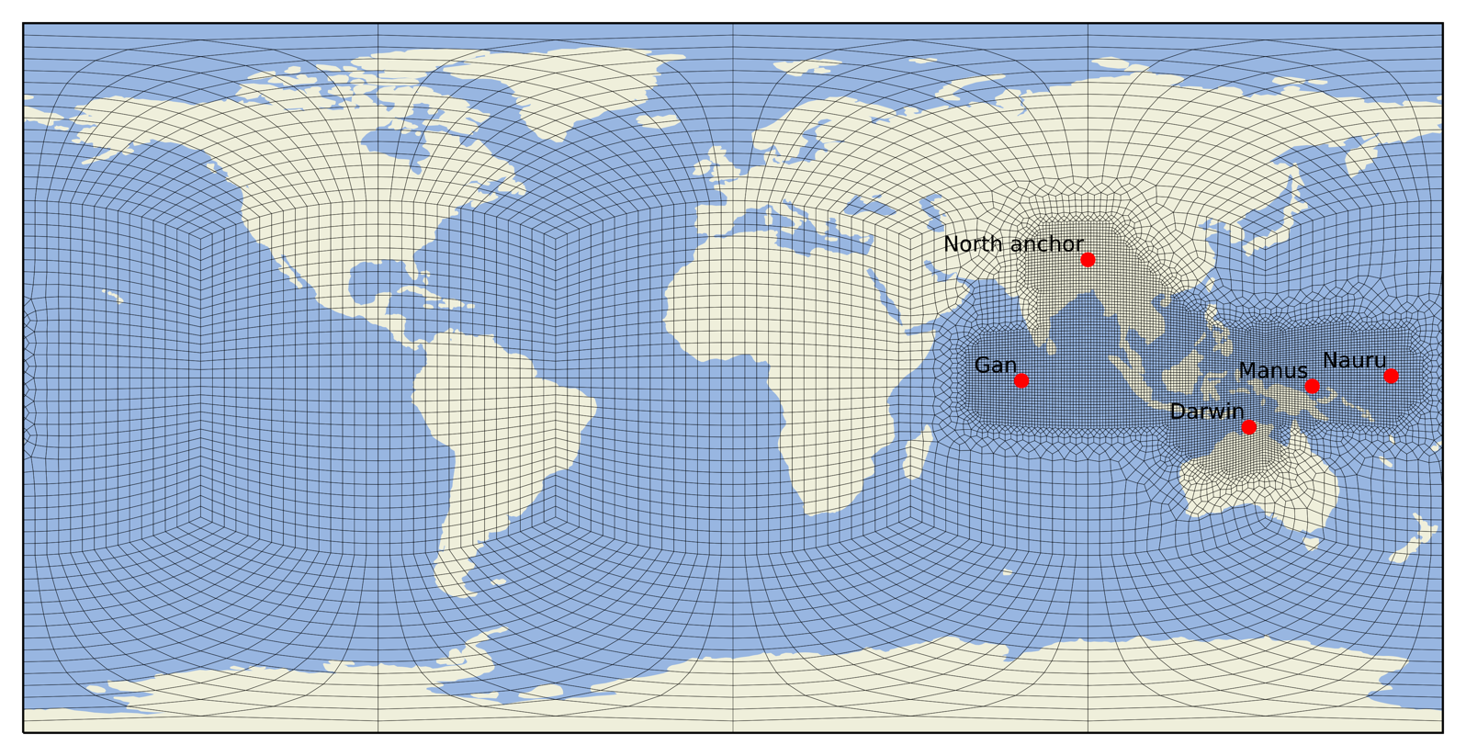
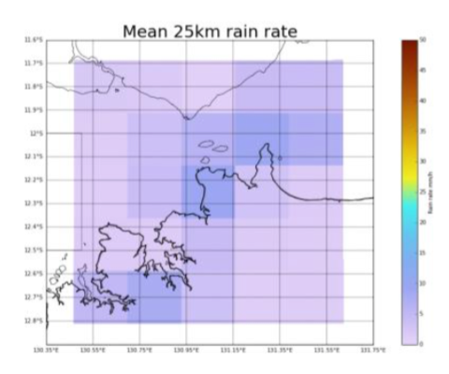
Climate Model Development and Validation (CMDV)
An activity of US DoE that brings instrument science, process science and climate modelling under one tent.
In order to accelerate development progress for the Accelerated Model for Climate and Energy (ACME) an activity was formed that encompasses most climate science activities within DoE.
This forms teams that explicitly includes members from both measurement and modeling.
One activity focuses on the use of regionally refined meshes to test new parameterizations to be used tomorrow on the computers of today.
The dynamical and microphysical properties of wet season convection in Darwin as a function of wet season regime. Robert Jackson, Scott Collis, Alain Protat, Leon Majewski, Valentin Louf, Corey Potvin, and Timothy Lang Thu, 27 Apr, 17:30–19:00, Hall X5, X5.152

Slide 11
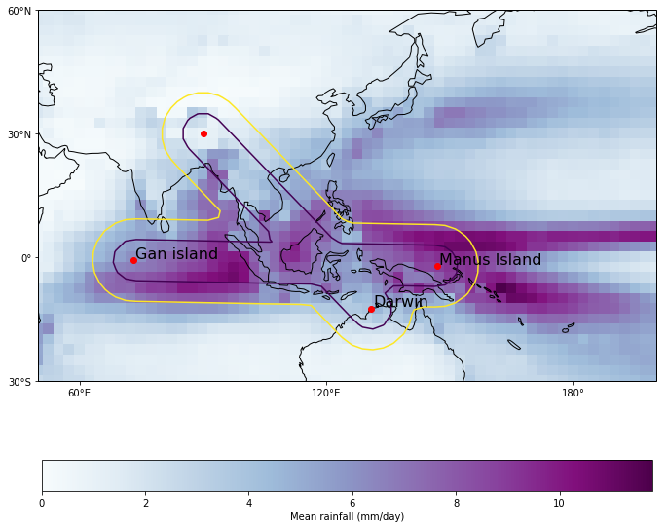
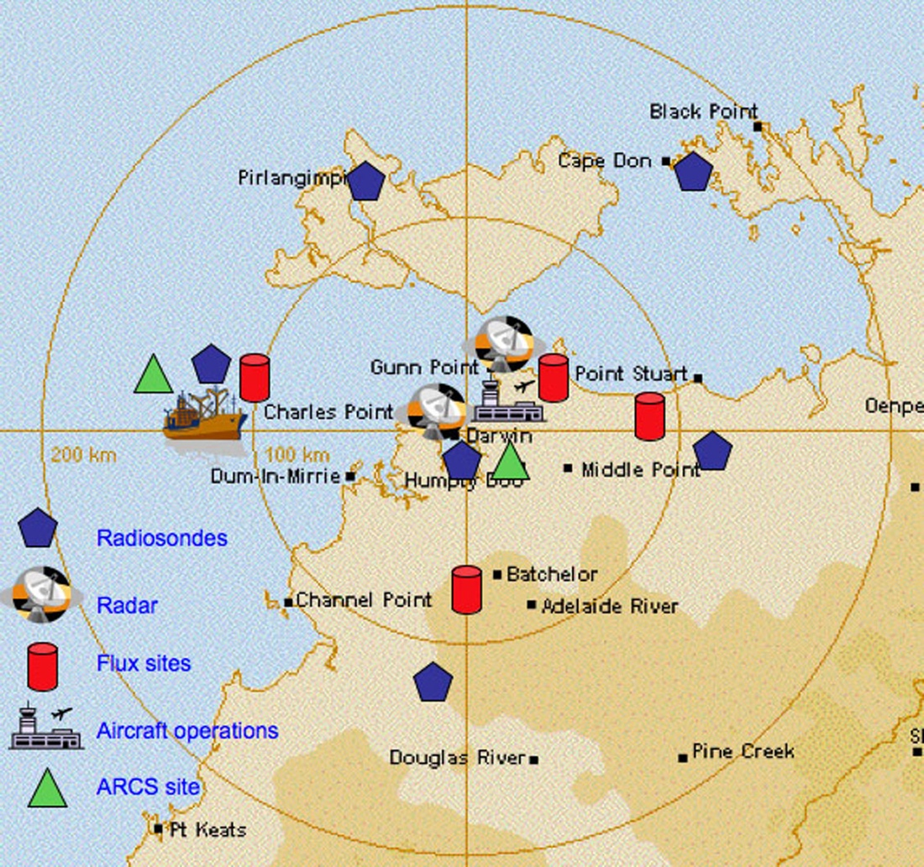
Darwin, Australia
A convective sandbox
Darwin is located in Northern Australia, 11 degrees south.
Shallow ocean -> SSTs ~30c.
Variety of meteorological influences:
Equatorial waves/MJO
Land mass interaction, extended dry season, monsoons from the north.
Local coastline impacts for convective triggering in conditionally unstable regimes.
Ideally suited for regime classification, highly distinct forcings and atmospheric response.

Slide 12
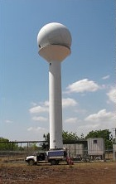
The C-Band dual Polarimetric Radar
A long term, regular, measure of tropical rainfall
Modified EEC 250kw Magnetron based C-Band Doppler radar to dual pol.
Linear pol (ATAR), in-house signal processing.
Moved to current location, 23km from Darwin at the start of the 1998 wet season.
Ten minute heartbeat:
Long range surveillance scan
18 tilt volume
RHI (Over ARM site and Profiler)
Vertically pointing ”Bird bath”
307,219 files collected, four different formats, ~6TB data.
See Keenan et al 1998
Keenan, T., Glasson, K., Cummings, F., Bird, T.S., Keeler, J., Lutz, J., 1998. The BMRC/NCAR C-Band Polarimetric (C-POL) Radar System. J. Atmos. Oceanic Technol. 15, 871–886. doi:10.1175/1520-0426(1998)015<0871:TBNCBP>2.0.CO;2

Slide 13
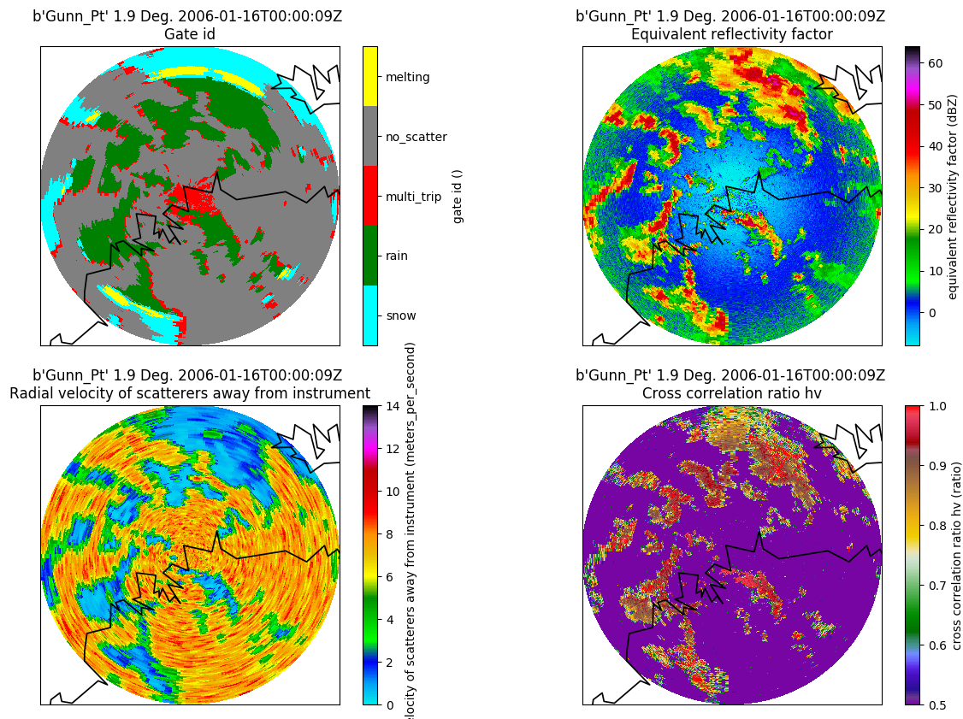
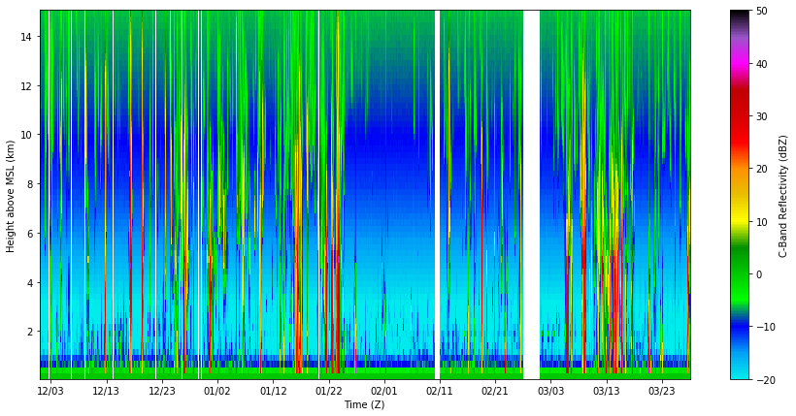
Processing and adding value
https://github.com/EVS-ATMOS/CABABORR
Radar science as a team sport
Collaboration between Argonne, Australian Bureau of Mereology and Brookhaven.
We use the Corrected Moments in Antenna Coordinates (CMAC2.0) approach, this uses the Python-ARM Radar Toolkit (Py-ART) and computing gate-ID on the raw data to avoid arbitrary conditional applications.
Steps are:
Ingest, read sounding and retrieve texture and Gate-iD
ZDR and Z offset (Birdbath, RCA)
KDP by Bringi, Giangrande and Maesaka methods.
Gates over instruments saved, QVP calculated.
All synchronized by using GitHub and Anaconda Python working environments. Data in Chicago and Melbourne.

Slide 14
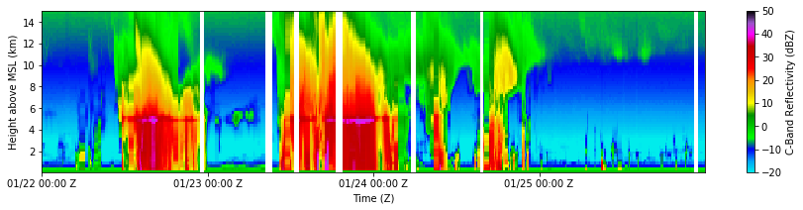
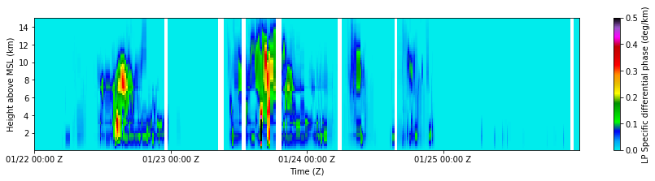
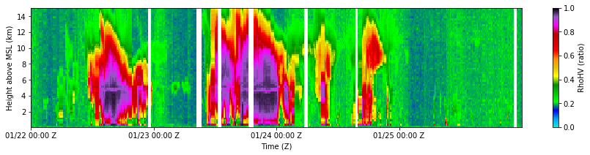

Slide 15
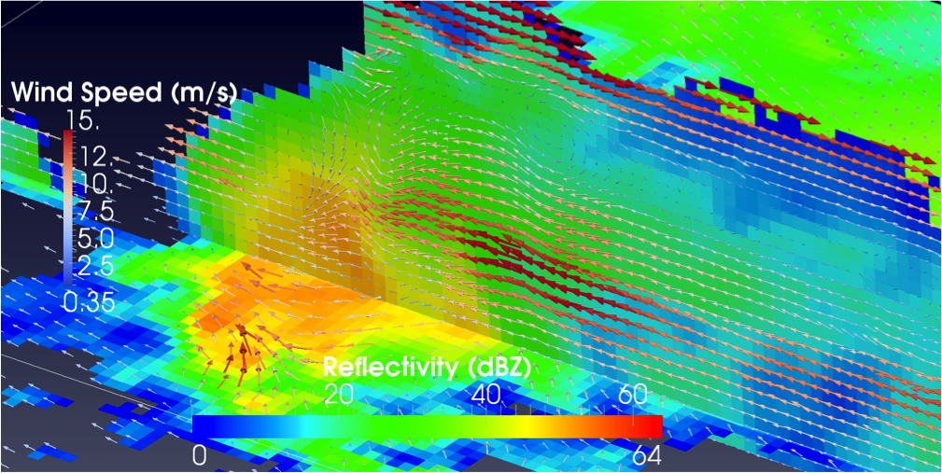
Two radars are better than one!
There is a doppler C-Band 30km from CPOL.
Use NASA Multi-Dop to do ~ 3DVAR retrievals.
Variationally retrieve three dimensional wind field by using a gradient conjugate algorithm to minimize a cost function involving:
Cost due to disagreement between projected radial field of the guess and radar radial velocities.
Roughness cost.
Cost due to w guess violating the anelastic mass continuity equation
https://github.com/nasa/MultiDop

Slide 16
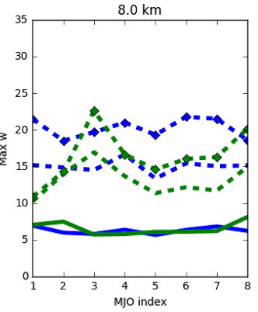
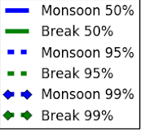
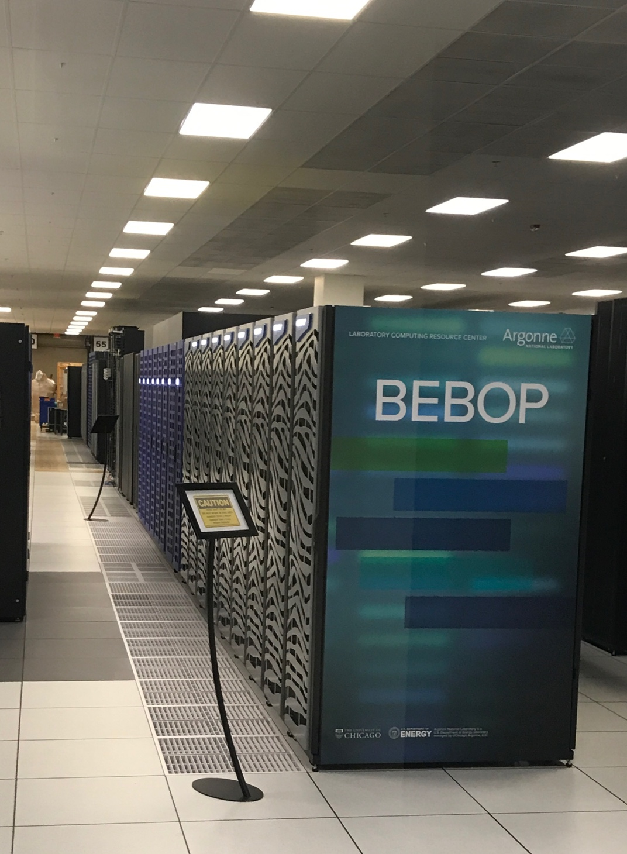
40,000 Multi Doppler retrievals…
Data at scale with Dask

Slide 17
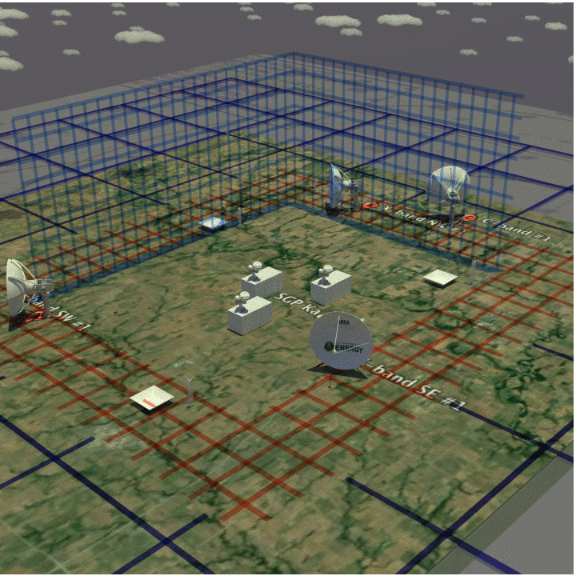
Part Two: The present
Open radar data as a service.. Our day job.
I am the “Translator” for ARM’s C and X band radars that target precipitation processes.
ARM, the Atmospheric Radiation Measurement Program is a user facility administered by the DoE Office of Science and run by a consortium of DoE labs.
ARM’s goal is to produce data that is used to improve the representation of radiatively important species in models across scales.
ARM runs three fixed sites (Northern Oklahoma, Azores and Alaska) and three mobile facilities.

Slide 18
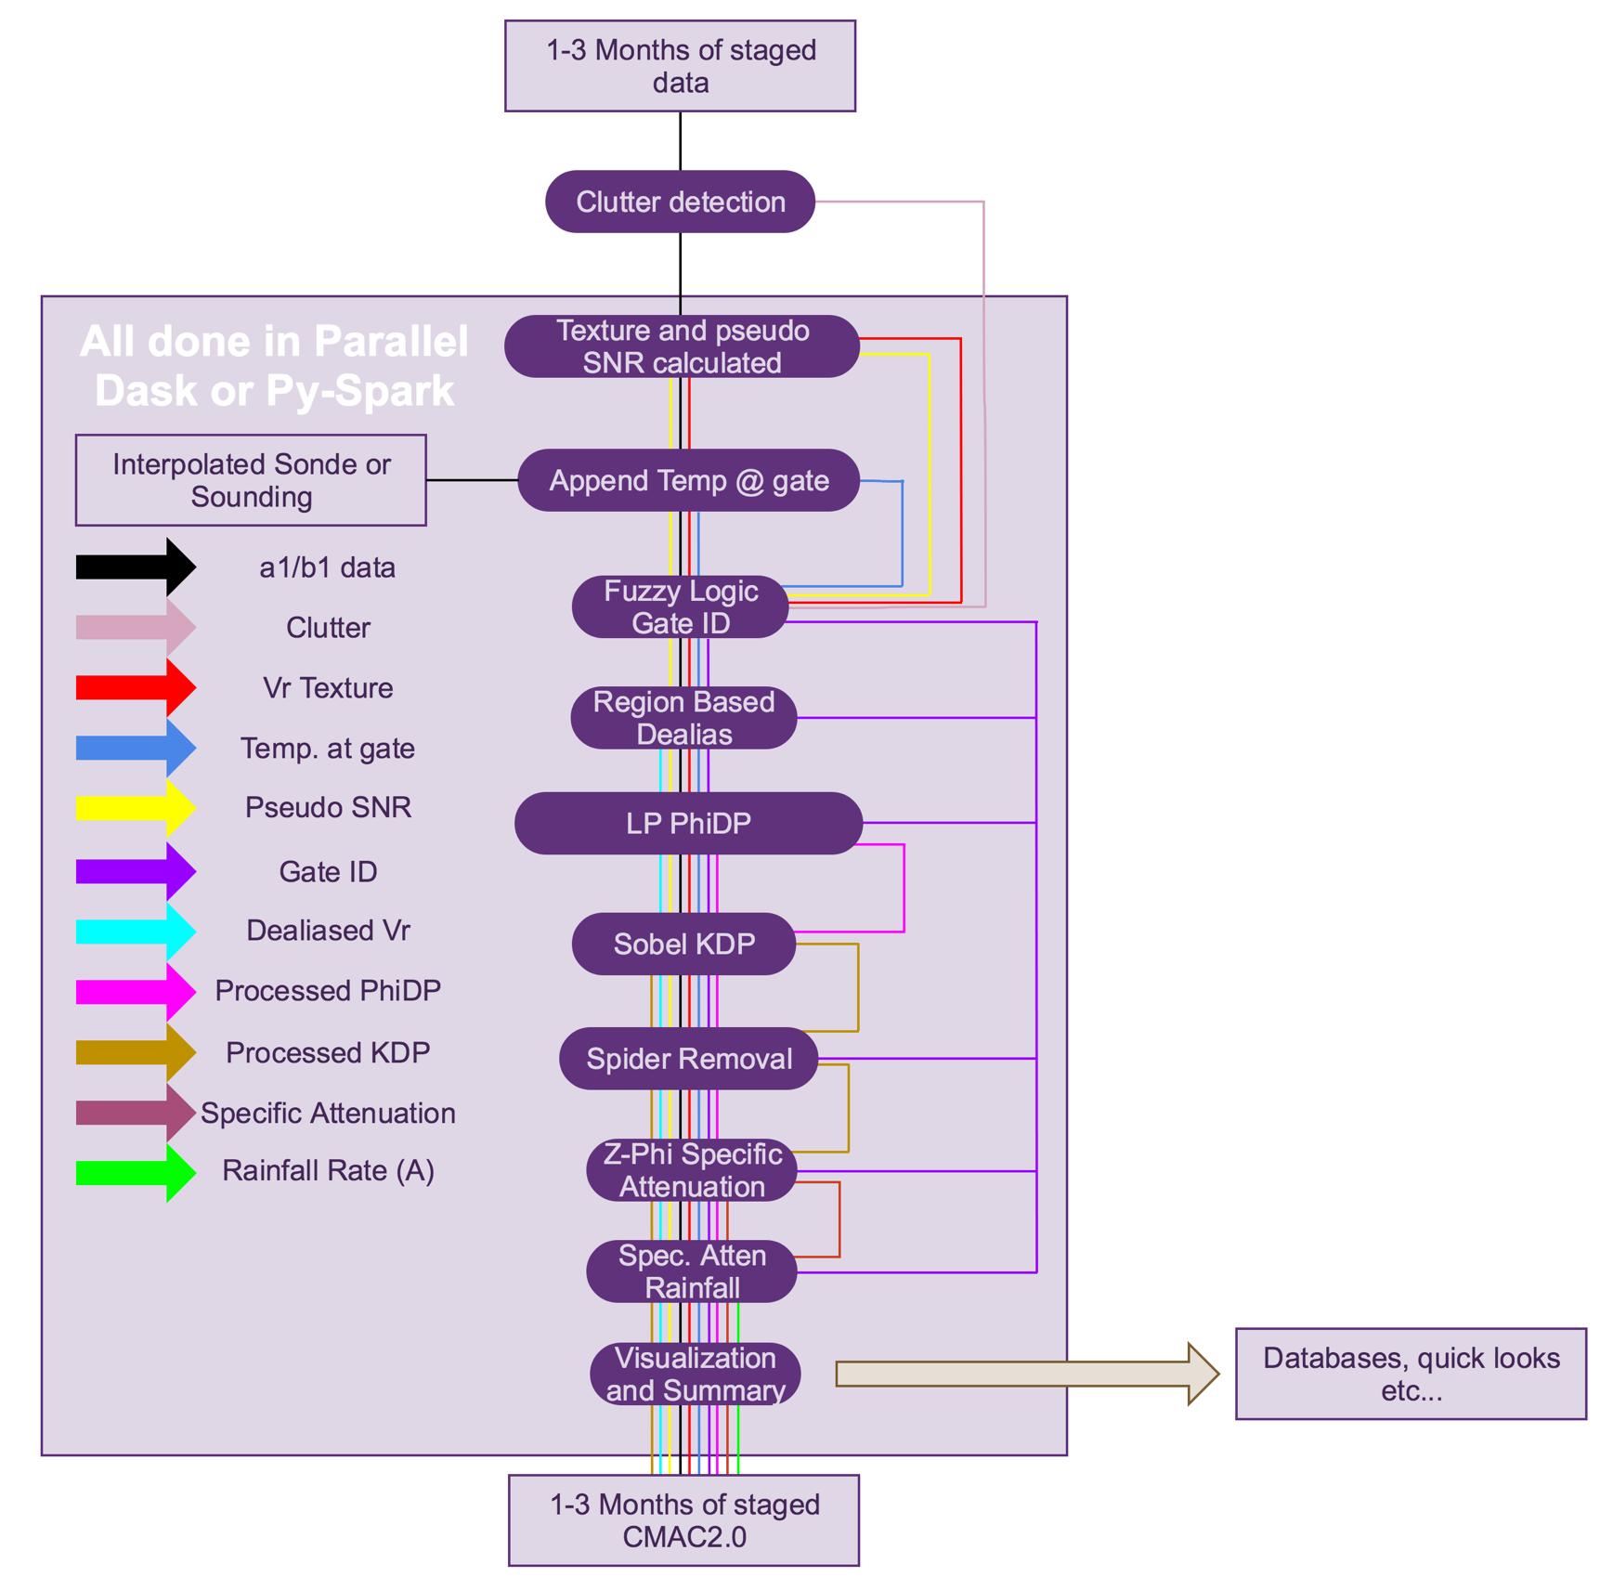
Adding value
First, create the best radar data..
Raw radar data is.. Well.. Very raw.
We alluded to our processing chain earlier on.. Here we give more detail.
Corrected Moments in Antenna Coordinates is, by nature, a Py-ART way of approaching radar processing.
The key is the first step is to try to characterize the nature of the scatterer first and use that as an input to down stream processing.

Slide 19
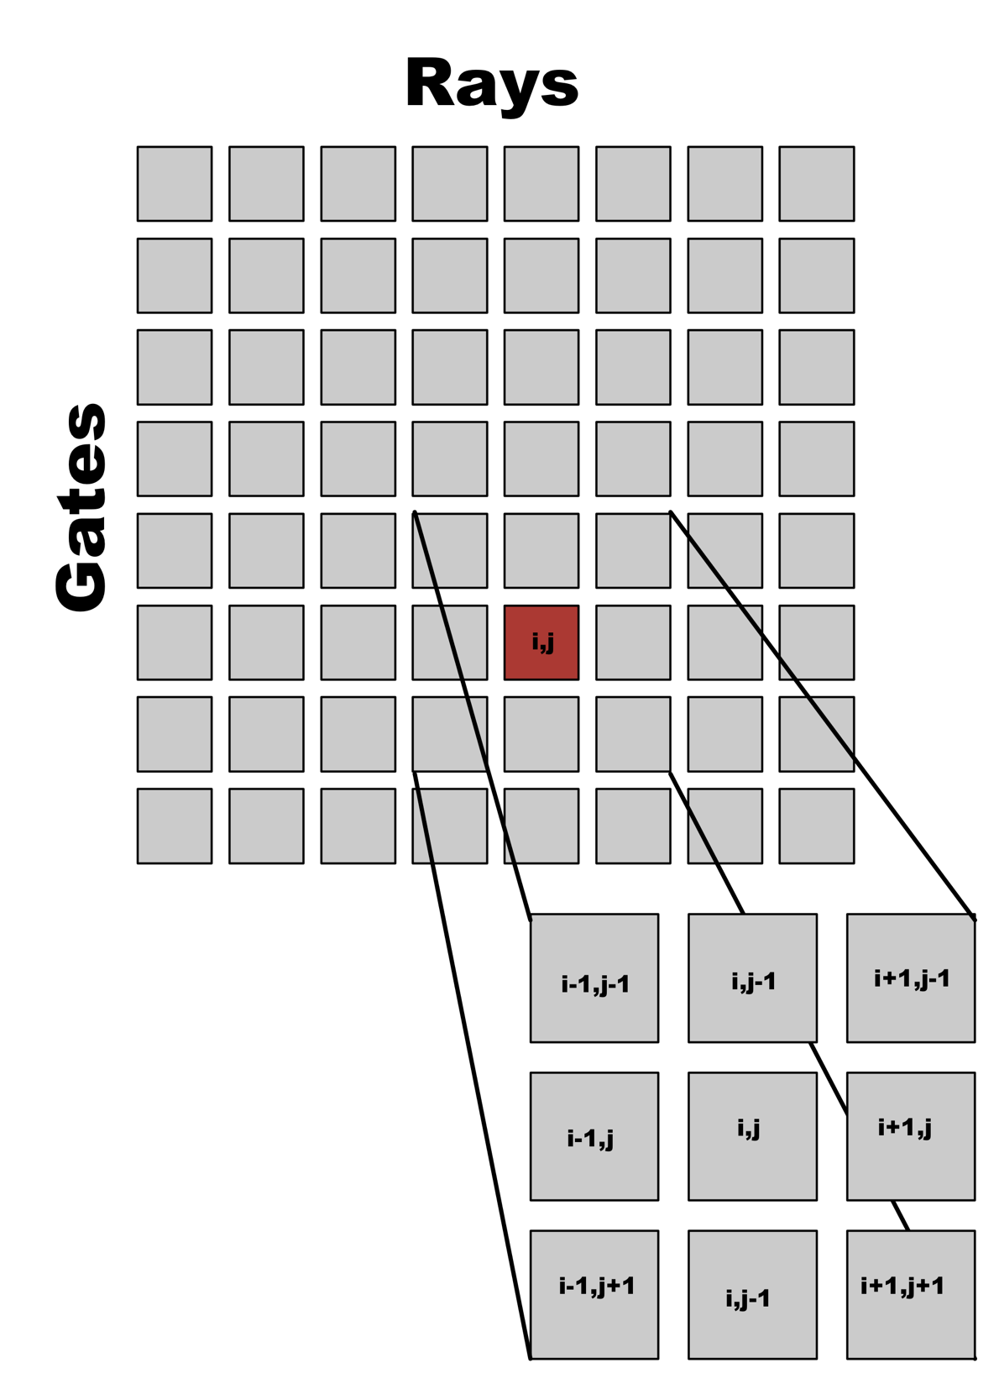
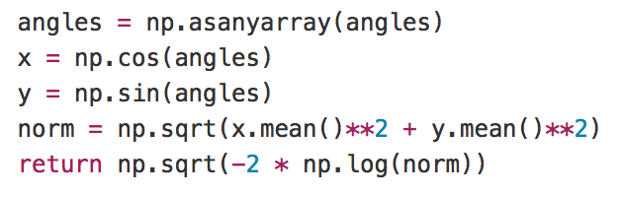
Texture calculation using circular statistics
Magnetron systems have randomized phase on transmit.
The texture of radial velocity is an ideal indicator of the existence of a valid first trip echo.
We want to work on the pre-dealiased data and the aliasing jump will cause false texture.
Answer: Calculate texture using circular statistics so going through nyquist is just going through
Scipy’s ndimage module is then used to convolve this with the radar image.
https://en.wikipedia.org/wiki/Directional_statistics

Slide 20
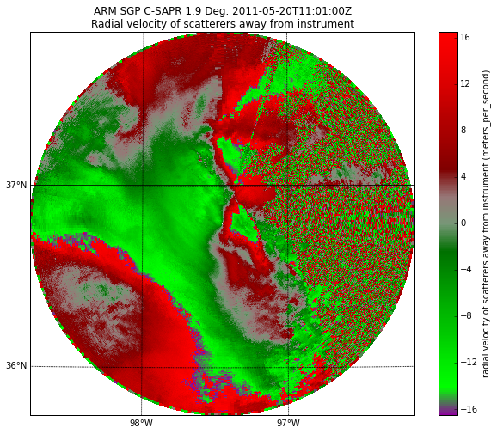

Slide 21
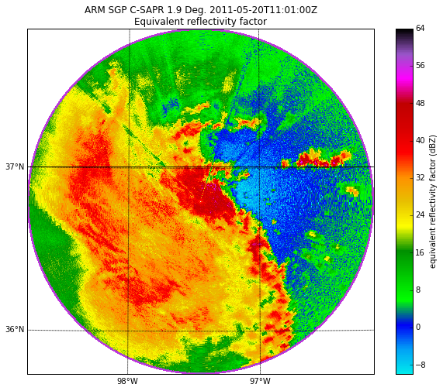

Slide 22
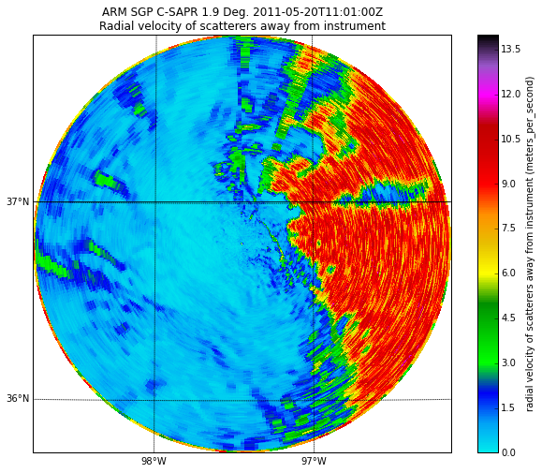

Slide 23
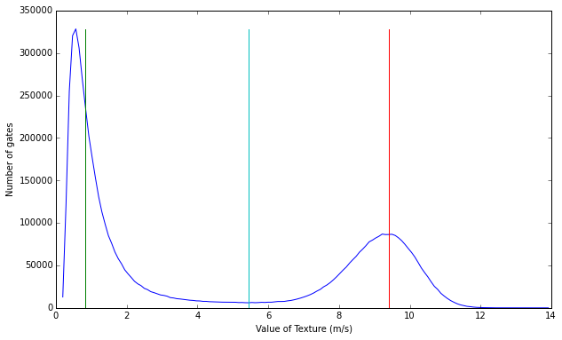
Enter texture

Slide 24
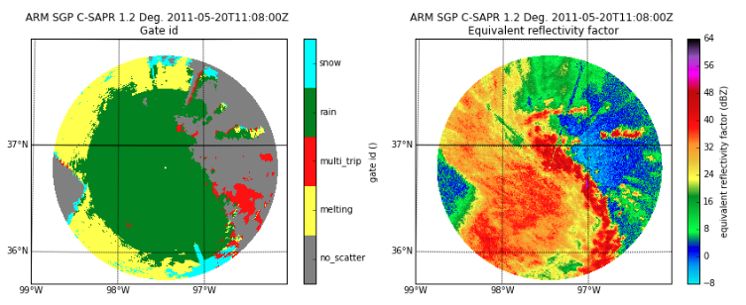
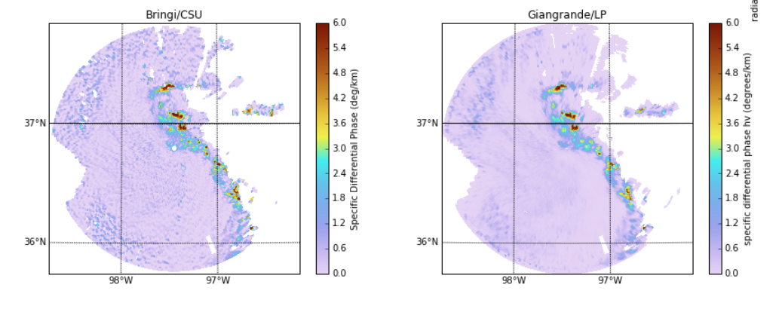
Fuzzy logic based Gate ID
But, unlike others we do it on the raw data…

Slide 25
And we do it at scale…
Cat videos to the rescue!
One advantage to working in the Python ecosystem is that we get to use tools developed by people with bigger problems than us.
Radar data is pleasantly parallel if you can treat each volume independently.
ARM has worked with Oak Ridge National Lab to build a 1024 core memory rich (8GB/core) cluster.
We have used two distributed computing packages, Dask and PySpark, and achieved good scaling.
At AMS Austin? Bobby Jackson will be giving a talk Monday morning in the Python Symposium.

Slide 26


Part three: The future (in Texas?)
Working with MCS’ made me want to return to isolated convection
The ACPC- Aerosols, Clouds, Precipitation and Climate group of IGAC (NASA, NOAA, NSF) is interested (as are we all) the role aerosols play in convective invigoration and precipitation production.
Houston has been suggested as a good site for a field study as, in on-shore flow conditions storm transition from a region where the aerosols are natural (oceanic) to anthropogenic in the Houston metroplex

Slide 27
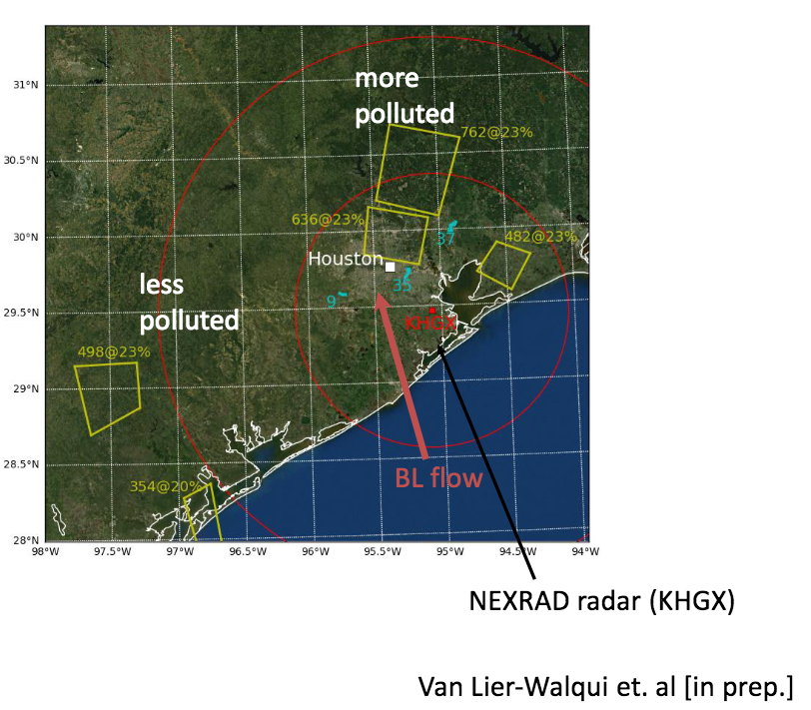
Houston

Slide 28
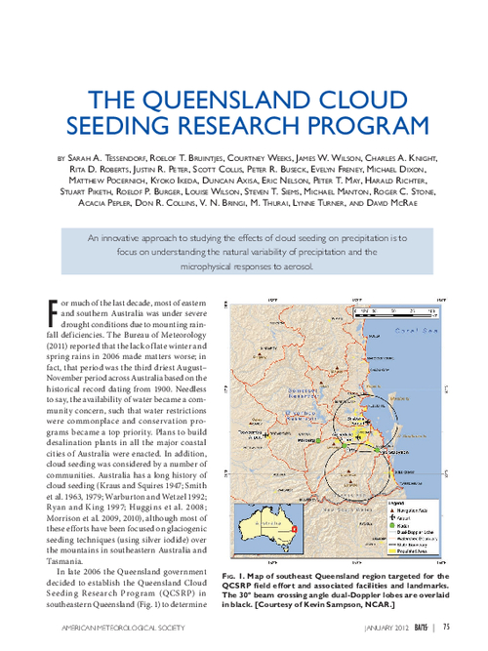
Some fundamental science questions…
That we do not yet have the data to answer
When a storm transitions from a ”pristine” to a “polluted” airmass the CCN concentrations and hygroscopicity changes.
This in turn should have an impact on microphysics, especially when there is an abundance of CCN.
Rapid generation of CLWC/RWC increases latent heating and parcels. Vertical velocity also is a control on microphysics.
This is not new.. Fundamental idea behind cloud seeding
But.. Chicken and egg.. What leads what lags?

Slide 29
Some fundamental science questions…
That we do not yet have the data to answer
Radar revist time in a “Standard mode” is ~10 minutes.
What is the response time of microphysics to dynamics and dynamics to microphysics?
How do we even ensure that an updraft at T2 is the same as what we saw at T1 (Lagrangian versus “snapshot”).
To study these interactions we need rapid revisiting of the same (in a Lagrangian sense) volume faster than the process time. Basic math from fall speeds points to need to revisit ~1 min.
20-s RHI (top) and synthetic RHI from
standard 6-min C-SAPR volumetric scan (bottom)
of the same convective cell near Manus.
Source: Adam Varble/Univ. of Utah

Slide 30
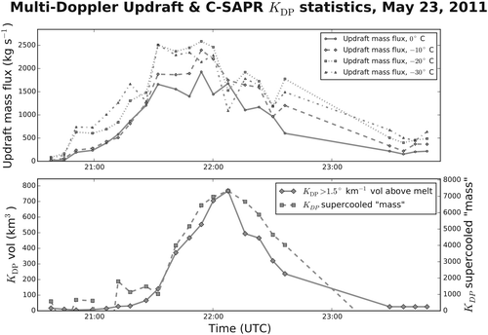
Past work from Oklahoma
van Lier-Walqui, M., Fridlind, A.M., Ackerman, A.S., Collis, S., Helmus, J., MacGorman, D.R., North, K., Kollias, P., Posselt, D.J., 2015. On Polarimetric Radar Signatures of Deep Convection for Model Evaluation: Columns of Specific Differential Phase Observed during MC3E. Mon. Wea. Rev. 144, 737–758. doi:10.1175/MWR-D-15-0100.1

Slide 31
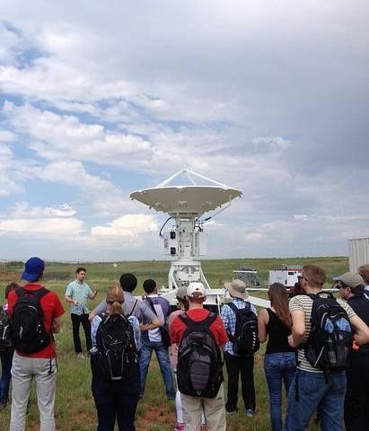
Houston ARM deployment
Adaptively follow storms using a science radar
Could we propose to ARM to deploy, along with the rest of the ARM mobile facility, the C-SAPR2 deployable Dual-Pol research radar?
And can we ask to receive engineering support to adaptively follow storm cells based on what is seen on the radar or nearby NEXRAD KHGX?
Before we do any planning or theorizing on how we would operate we first need to understand Houston convection.
When (seasonally) are we most likely to get nice isolated cells?
What is the behavior of these cells?
Life cycle
Formation points
Dissipation points
Photo courtesy ARM Flickr

Slide 32
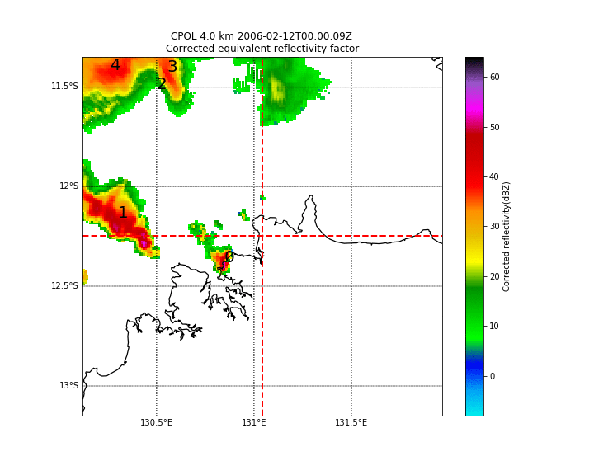
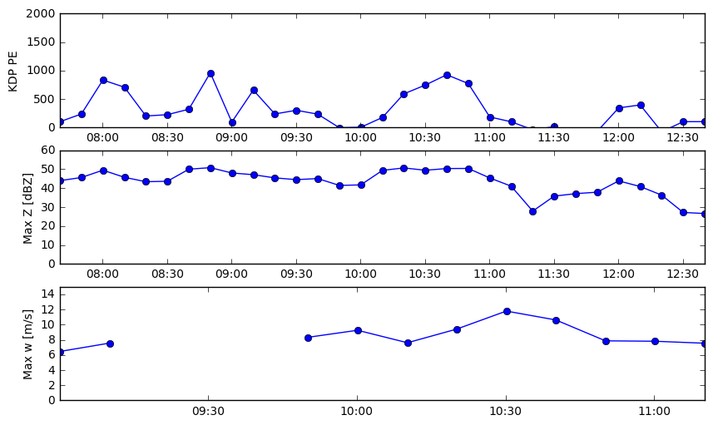
TNT
Is
Not
TITAN
https://github.com/openradar/TINT

Slide 33
Three years of NEXRAD dual pol data
Building 2D PDFs for model evaluation
Following on from our work in Oklahoma we know that K_{DP} (reminder: Anisotropy of RWC) lofted volume is a good proxy for updraft strength.
So now with 3 years of data can we see any good statistical behavior.
We see nice relationship between K_{DP} and storm size.. Early results (reported at AMS Radar).

Slide 34
The storm cell database as a tool to design an experiment.
How many cells do we see in three
years.
What is the best time to deploy to Houston?
If we want to look at full cell lifecycle what is the required range?
Where do cells initiate? How uniforms are cell tracks?
Not only are cell tracks a great way to answer this they reduce a 10TB data set to less than a GB.

Slide 35
The storm cell database as a tool to design an experiment.
How many cells do we see in three
years.
What is the best time to deploy to Houston?
If we want to look at full cell lifecycle what is the required range?
Where do cells initiate? How uniforms are cell tracks?
Not only are cell tracks a great way to answer this they reduce a 10TB data set to less than a GB.

Slide 36

So what should you take away?
Chipping away at the problem. But only once.
All science is incremental.
Every now and then those increments add up to something amazing but the final press release is the destination not the journey.
Open data and open source software means quicker uptake of previous research results. Papers are very hard to reproduce.
Our team works on problems using a mix of old and new data. We specialize in bringing HPC to the problem.
Always looking to collaborate. Especially interested in training the next generation of scientists to be open (and use Py-ART!)

Slide 37
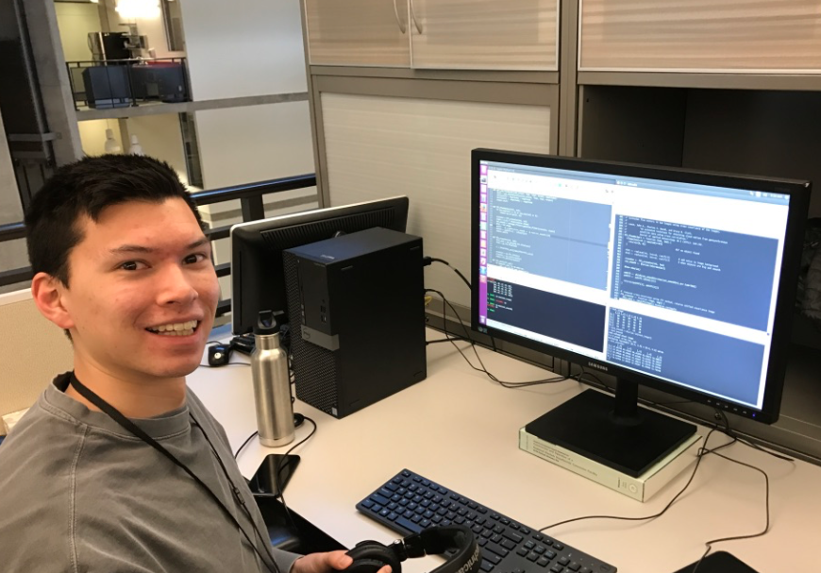
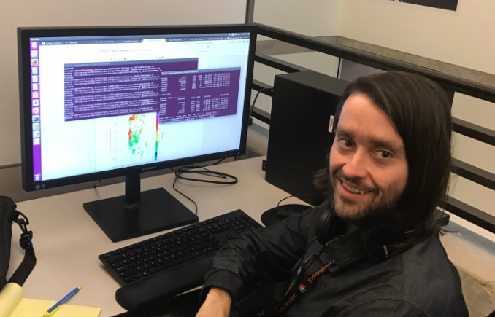
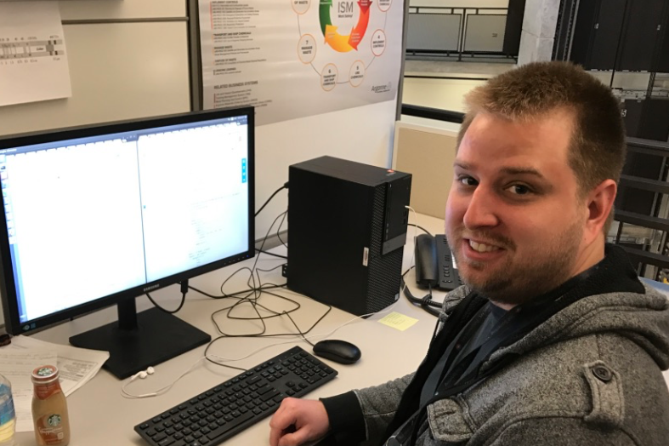
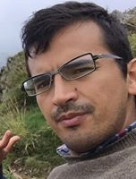
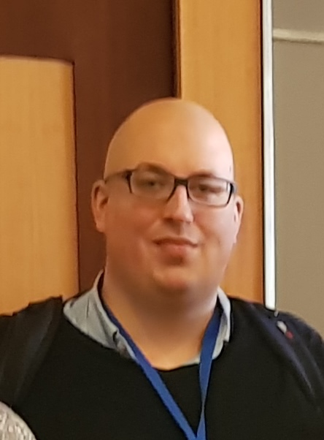
This presentation has been created by UChicago Argonne, LLC, Operator of Argonne National Laboratory (“Argonne”). Argonne, a U.S. Department of Energy Office of Science laboratory, is operated under Contract No. DE-AC02-06CH11357. This research was supported by the Office of Biological and Environmental Research of the U.S. Department of Energy as part of the Atmospheric Radiation Measurement Climate Research Facility.

